Slide 1

RAISE SUMMIT HACKATHON · PARIS · JULY 2026
Paths, not destinations
how winning hackathon teams think
Rob Whelan · Sr. Eng Mgr, Grafana Labs, AI
Notes:
EM in Grafana Lab’s AI dept.
You may know Grafana Labs & Grafana Cloud already
But today, what’s most useful? Let’s talk about hackathons

Slide 2
We hack, a lot
5–6
Grafana Assistant
born in a hackathon — project “Dash”
hackathons a year, every year
Grafana AI Observability
four full weeks + offsite mini-hackathons
born in a hackathon — project “Sigil”
We’ve watched a lot of hackathon projects live and die. There are patterns.
Notes:
Grafana Labs runs five or six hackathons a year - four full week, full company ones, plus half-day hackathons at dept offsites. Our AI Assistant started as a hackathon project called Dash. Our whole AI Observability platform came out of one called Sigil. So we've watched a lot of hackathon projects live and die. There are patterns in the ones that win & ship versus the ones that end when the demo does.

Slide 3
Great projects are paths, not destinations.
Three blanks every winning team can fill in:
Immediately valuable
Safe to try
Better next week
because ______
because ______
because ______
value on the first touch if at all possible
no “first, grant us all this access and deploy all this stuff”
what compounds as people use it?
Fill in all three: you have a project. Fill in one: you have a demo.
Notes:
The biggest pattern is even more impt now: it’s so fast to make new features & demos; your actual users are maybe building their own thing, or have a million new choices they don’t trust.
Great projects are paths, not destinations. Not 'look, this cool thing is now possible' - but three blanks you can fill in.
It's immediately valuable because ___. It's safe to try because ___ - no 'first grant all this access, deploy all this stuff, then it's amazing.'
And it gets better from there because blank. If you have no path, just a great landing point, you have a fun demo, not a winning project.

Slide 4
What judges reward
1
It works.
a live demo beats any story
2
It’s creative.
interesting enough to remember tomorrow
3
It has real impact.
for someone specific, not “anyone could use this to do something”
A few minutes go very fast. Save some hacking time to prepare your pitch.
Notes:
In this hackathon, you have only a few minutes, so prepare what you’ll show & say! Judges care about 3 things: It works. It's creative and novel. And it has real impact - for someone specific. [Segue] Creativity is yours - I can't help with that part. But the other two are loop problems, and those we know something about.

Slide 5
Pay attention to your loops!
THE FLYWHEEL — growth over time, in your vision
BIG LOOPS — product feedback
Little loops → a demo that works by Sunday
LITTLE LOOPS — agent tasks
define done · test · watch · push
Big + biggest → impact that compounds
Same rule at every scale: know what done looks like — and be able to see it.
Notes:
So you need this working by stopping time tomorrow, with a solid vision for real impact: both solved with good loops.
Little loops get you a demo that works. Big loops make it matter. Same rule at every scale: know what done looks like, and be able to see it. Let's take them in order.

Slide 6

Little loops: define “done” for every agent task
a test that passes
a log line that shows up
a Playwright run that actually clicks the button
Agents grind in parallel. You brainstorm the next user flow with your team — you’re designing, not babysitting.
Notes:
Everyone here is building with coding agents. The single highest-leverage habit: for every task you hand an agent, define done. A test that passes. A log line that shows up. A Playwright run that actually clicks the button. Do that and your agents work in parallel while you and your teammates brainstorm the next user flow - you're designing the product, not babysitting the tools.

Slide 7
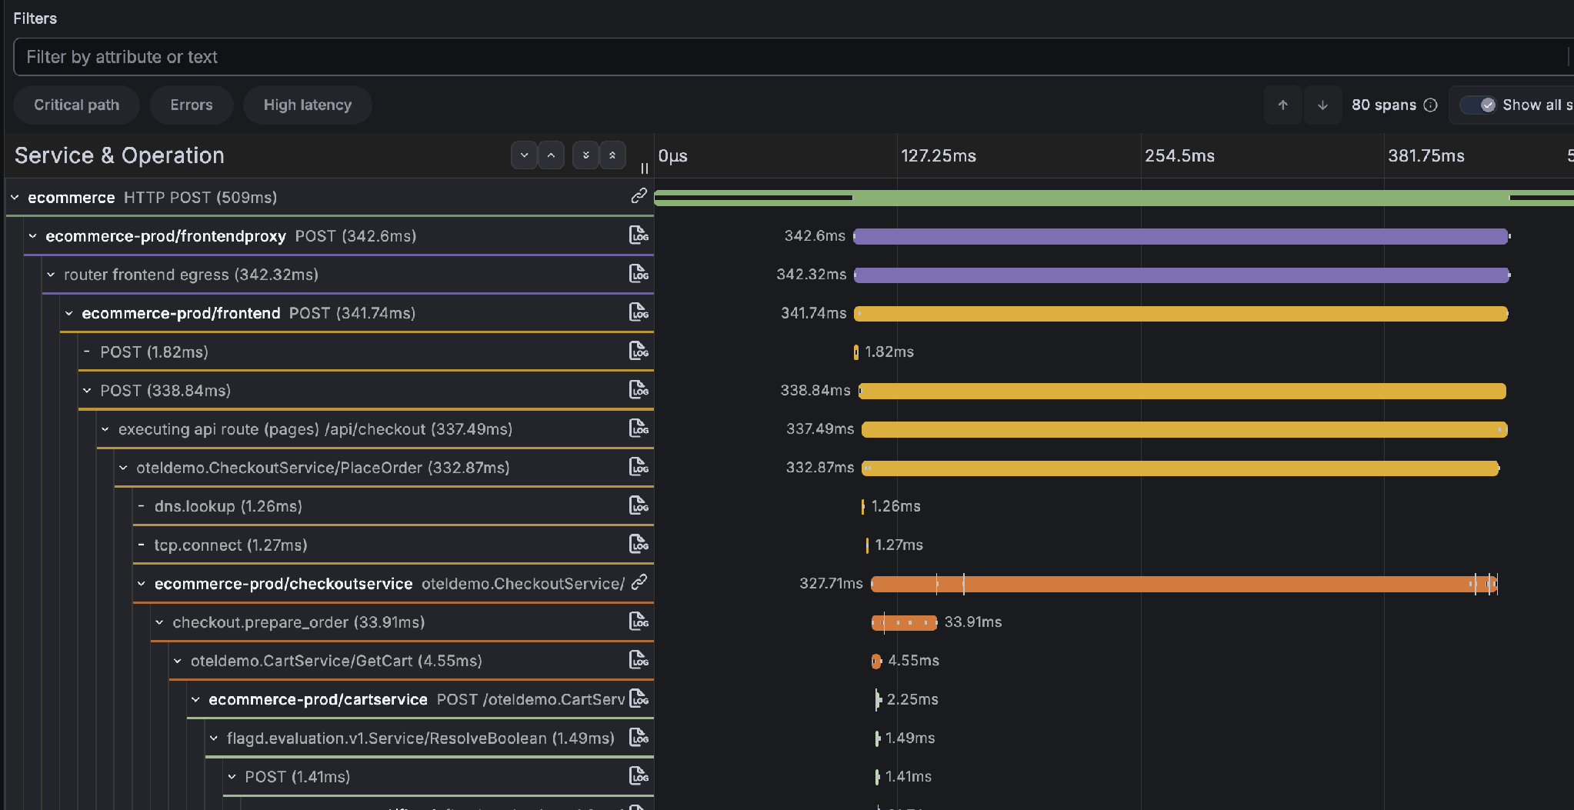
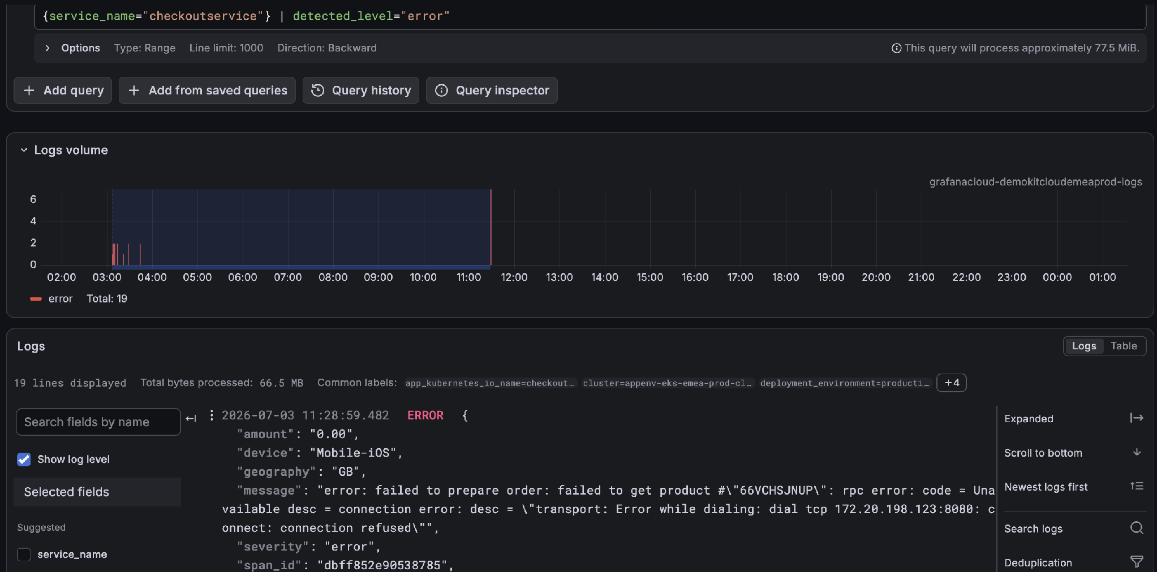
See what’s actually happening
Logs: one query, errors only
{service_name="checkoutservice"} | detected_level="error"
Traces: the whole flow, span by span
Half a day is enough to build something sophisticated — if you can see it.
Notes:
This is a trace of a request flowing through services - the same view works for your agent runs. Half a day is enough to build something genuinely sophisticated - IF you can see what actually happened when something breaks. One log query filtered to errors answers 'is it done?' Logs and traces aren't ops overhead this weekend. They're your speed.

Slide 8
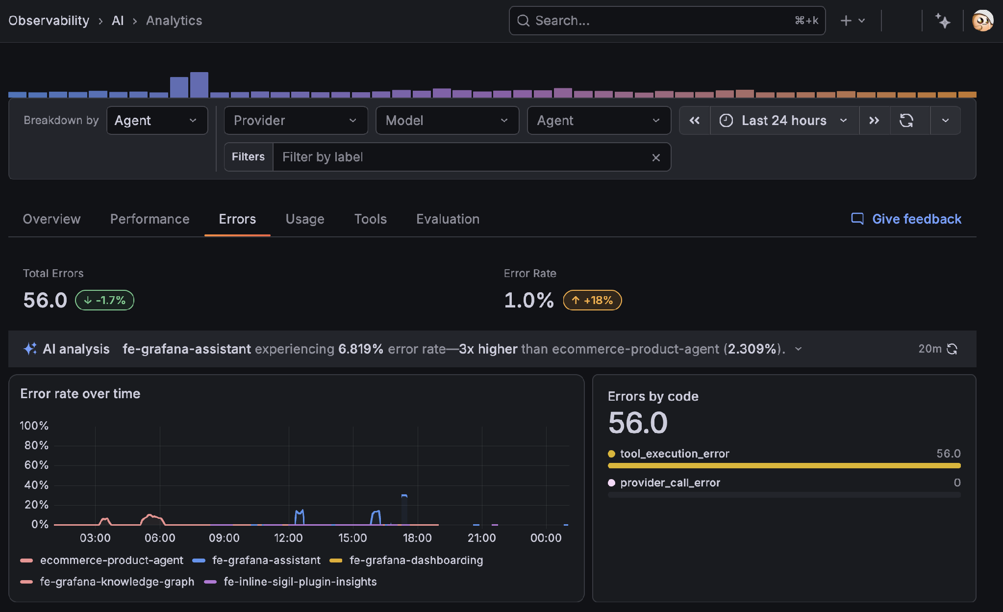
BIG LOOPS — THE TRAP OF BUILDING ON AI
AI always returns something shaped like a good answer.
Your users can’t verify it either — they don’t know the right answer.
“80% useful” can mean “wasted your afternoon.”
AI Observability: error rate per agent, errors by code — out of the box
The defense: instrument the product itself. Which outputs got used? Where did people bail? What did they retry?
Notes:
Now the trap with building on AI: LLMs always returns something shaped like a good answer. You can't tell 80-percent-useful from great by looking - and your users definitely can't, because they don't know the right answer and can't verify it. 80% useful can mean 'wasted your afternoon.' The only defense is a feedback loop on the product itself: which outputs got used? Where did people bail? What did they retry?

Slide 9
The biggest loop is your growth story
People arrive —
for a reason
They use it
…and more people arrive
Data makes it
better
Usage creates
data
That’s what “real impact” means on the scoresheet: not what you built — why it compounds.
Notes:
Zoom that loop out over time and it becomes your growth story. People show up for a reason. Using the product generates data. Data makes the product better. Better pulls in more people. That's the data flywheel - if this is part of your vision, that’s hugely valuable.

Slide 10
A flywheel you can’t see
isn’t a flywheel.
It’s a claim.
Notes:
But - a flywheel you can't see isn't a flywheel. It's a claim. Thinking after hackathon: it’s a nice pitch deck with no proof.

Slide 11
Sunday, then beyond hackathons
YOUR PITCH SCRIPT
After the hackathon: “How do you know?”
Instrumentation is the difference between an answer and a shrug.
Vision: here’s how real users will start with confidence
How the value grows
Proof it works
The same evidence works on investors — or your leadership.
Growth story + instrumentation = proof. Without it: a pitch deck.
A few minutes or judges now; bigger pitches (with proof) down the road
Notes:
You get a few minutes to pitch tomorrow; beyond that, though – you’ll need evidence for these questions beyond “does the POC work?”. Whether you're in front of investors or your own leadership: a growth story with instrumentation behind it is proof. Without it, it's a pitch deck.

Slide 12

Grafana has your back
Free forever
No lock-in
Grafana Cloud’s free tier for small teams — this weekend, and long after it
Open source at the core — when you grow, you grow on your terms
Minutes to wire up: agent traces · error logs · product + flywheel metrics
Watch it. Don’t wonder.
Notes:
These are ideas we use internally, and also, we have your back.
Grafana Cloud is free forever for small teams. And when you grow, the core is open source, so we don't lock you in. Wire it into your project in minutes, and everything I just described - agent traces, product feedback, flywheel metrics - is something you can stay on top of, not wonder about.

Slide 13

Grafana Cloud — free
Jo’s workshop · this afternoon · 20 min
mentoring all weekend — en français aussi
Build the path. Instrument the loop.
Notes:
My colleague Jo is running a workshop this afternoon and diving into details on how to use Grafana on the site, from your coding agents, everywhere. The QR code gets you Grafana Cloud. And I'm around all weekend as a mentor - come grab me. En francais aussi, si vous preferez. Build the path. Instrument the loop. Merci, bon courage, bonne chance!

